Slide 1
Shell Bootcamp 2024 3 Reflections for Week 1
Puneet Kumar Sharma
Date : 31-Aug-2024

Slide 2

About Me
The more you know, The more you realize that you know nothing

Slide 3

My learnings from this week!

Slide 4
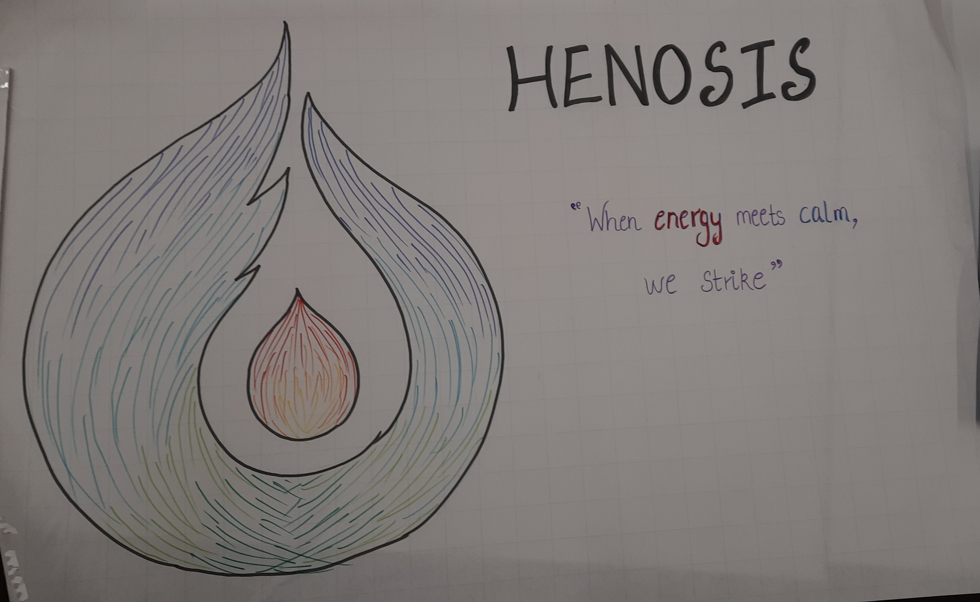
Teamwork | My takeaways
In this week’s soft skills classes I learned the importance of teamwork and why it is important to collaborate and work in a team.
The key takeaway from soft skills classes was that the creative potential of a team increases exponentially with increase in collaboration and coordination among its team members, this increase in creative potential can be seen in the output of the team or the delivery of the team.

Slide 5

Stakeholder Management | My takeaways
In this week’s soft skills classes I learned the importance of stakeholder management and why it is important to have proper communication between all stakeholders to bring project’s success.
The key takeaway from this week’s soft skills classes is that managing people is a complex and an important skill for a professional to have, this skill helps a professional to manage stakeholders having different expectations from the project to bring them all on same page.

Slide 6
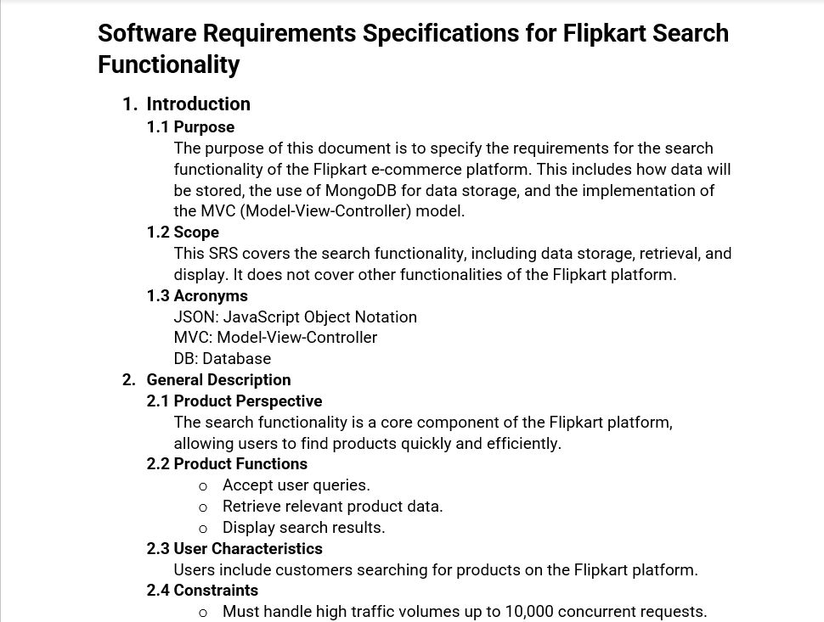
Role of a Business Analyst and BRD, SRS | My takeaways
In this week’s BA & Agile classes I have learned the importance of documenting all the requirements properly in any IT project. Particularly, I have learned the importance of BRD and SRS and how to properly draft these documents from a Business Analyst’s perspective.
The key takeaway from BA & Agile classes is the importance of getting approval on the requirements from the client and drafting a good SRS, So that client, developers and QA engineers are all on the same page and rework can be prevented.

Slide 7

Relevance of learnings for my organization

Slide 8
Teamwork | Relevance for Shell
Shell implements good teamwork by allowing its staff to schedule GTKYs with anyone, knowing your team member in terms of what type of a person he/she is, what are there strengths and weaknesses, promotes strong collaboration among team members and they become support for each other.
Shell benefits from this learning by promoting strong collaboration among team members such that the team acts as a single unit and the creative potential of the team delivers greater value.

Slide 9
Stakeholder Management | Relevance for Shell
Shell implements this learning by allowing people to freely express their opinions with respect and understand others' opinions with respect, in such a transparent environment the trust of stakeholders increase which in turn benefits everyone.
Shell benefits from good stakeholder management by generating value for its stakeholders, which is also an important part of Shell’s “Powering Progress” strategy.

Slide 10
Role of Business Analyst and BRD, SRS| Relevance for Shell
Shell implements this learning by providing adequate training for its people regarding these technical and business documents which in turn helps its people i.e., business analysts, developers and QA engineers to draft good BRD and SRS and understand them as well.
Shell benefits from this by means of productivity and efficiency that came with the proper initial documentation of any project. Proper documentation for any project acts as a kick start for it which in turn benefits Shell in timely completion of the project along with the quality of work.

Slide 11

Challenges in implementing learning

Slide 12

Challenge faced while implementing Teamwork
The challenge that I faced while implementing Teamwork was that of Time Management. It was reflected on me during the presentation activity. We were required to prepare an informative ppt on a topic of our choice in a short period of time, due to this limited time I faced some challenge in explaining what everyone needs to do (I ideated the ppt).
I plan to overcome this challenge by allowing myself to be more decisive and by reducing the amount of unnecessary time that I spend on thinking.

Slide 13
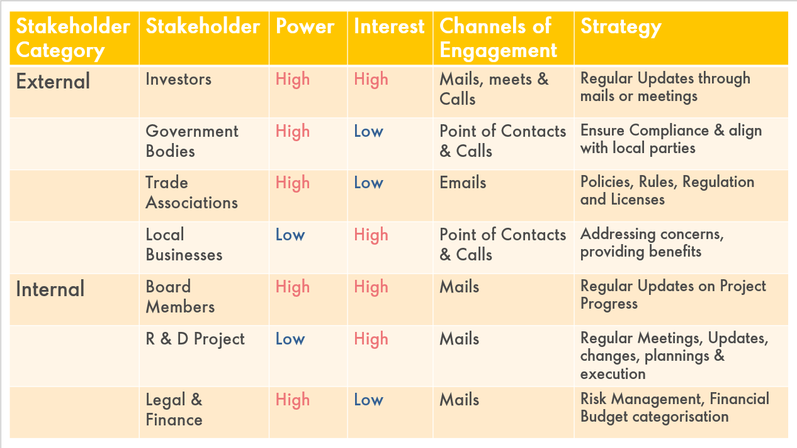
Challenge faced while implementing Stakeholder Management
The challenge that I faced in Stakeholder Management is the identification of stakeholders.
I Plan to overcome this challenge by listing each and every person involved in a project as characters in the order of their appearance in a scenario.

Slide 14
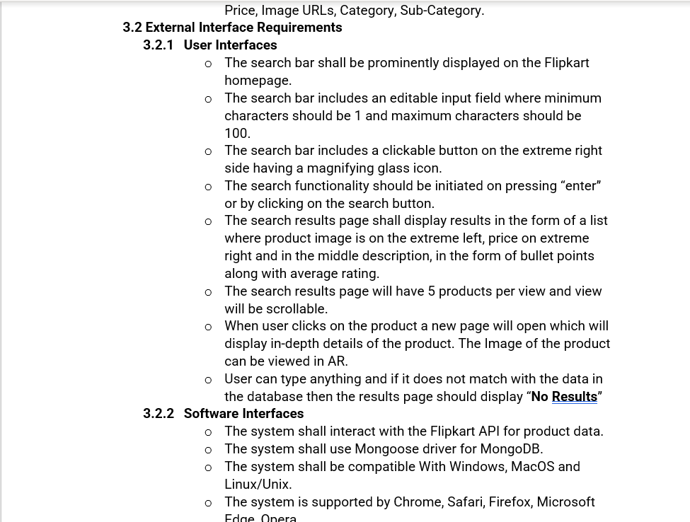
Challenge faced while implementing BRD and SRS
The challenge that I faced was during the translation of Business Requirements into Technical Requirements in the form of SRS. I was either going too technical or was missing some secondary technical requirements.
I plan to overcome it by effectively communicating with the Business Analyst and bringing myself on the same page as that of the client.

Slide 15

Action Plan

Slide 16
My Action Plan for this Week
Actions
Timeline
Status
Learning about important communication topics which are crucial for a professional.
Learning about key topics in understanding the role of a Business Analyst, drafting BRD and SRS and Agile Scrum.
Monday – Wednesday (3 Days for Soft Skills)
Thursday – Friday (2 Days for BA & Agile)
At the end of 3 days for Soft Skills I was able to assess myself in terms of soft skills and was able to greatly improve some skills which include Presentations, Stakeholder Management and Teamwork.
I was able to understood the characteristics of good BRD and SRS documents, SDLC models with emphasis on Agile Scrum.

Slide 17

Learning is also Fun!

Slide 18

Learning is also Fun!
The fun activity was done during the teamwork exercise of the soft skills training. In this activity we were part of a team and we were required to write a word with minimum 6 characters on a sheet, but the condition was that the marker or pen would be tied to strings and these strings would be held by four team members in North, South, East and West directions and they will try to write this word using this setup.

Slide 19

Summary
During soft skills training I was able to learn the important concepts of Teamwork and Stakeholder Management in an enjoyable manner with different fun activities. I was able to improve my communication and presentation skills by participating in the team and completing different short projects, the BA & Agile training provided me with the foundational knowledge of the role of a Business Analyst, how SRS and BRD are drafted and their importance along with Agile Scrum SDLC model.
Next week we are going to learn about Testing, DBMS and DevOps. Testing is an important skill to have for developers because they are expected to perform unit testing for a module, DBMS is a foundational Computer Science subject. Since, it is the place where data is stored and retrieved for business purposes. DevOps is all about development and operations team working together using pipelines and environments to reduce the time taken between writing code and deploying it.
Proper understanding of concepts such as Stakeholder Management, BRD and SRS helps to understand what to test, how much and where should the data be stored and in what format followed by how it should be accessed and used. Agile Scrum concepts helps to understand the development of environments and pipelines.

Slide 20
Thank You

